Slide 1
Novelty Detection in Text Streams
Erik Novak, Klemen Kenda
Supervisor: Dunja Mladenić
Text/Multimedia Mining and Semantic Technologies

Slide 2
Overview
Aim
Create a prototype for detection of new/previously unseen documents in a stream of documents.
Objectives
Provide a tool to optimize user experience when reading aggregated news sources.
Evaluate level of novelty.
Use EventRegistry as a data source.

Slide 3
Related Work
TODO: Erik

Slide 4
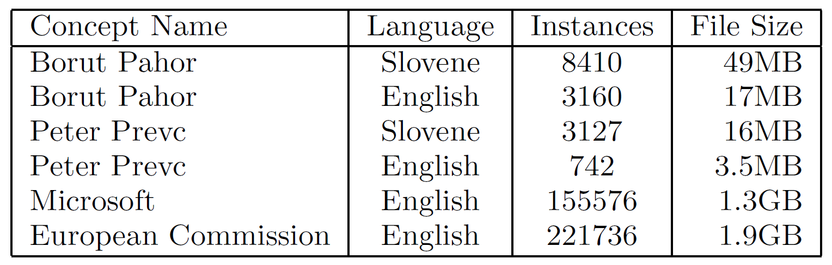
Data
Acquisition
Pre-processing
Event Registry (http://eventregistry.org)
From 2014-2017
News articles that include a particular concept
Simulated stream of news articles
TODO: Erik – preglej, dodaj

Slide 5
Feature Engineering
TODO: Erik

Slide 6
Methodology
k-Nearest Neighbors
Implementation
TODO: Erik
TODO: Erik

Slide 7
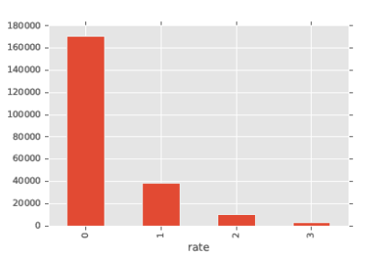
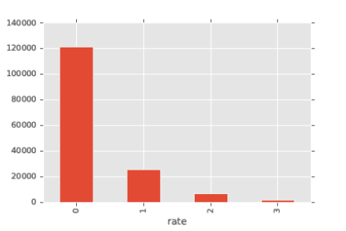
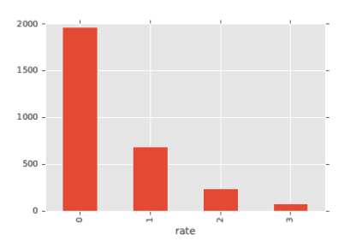
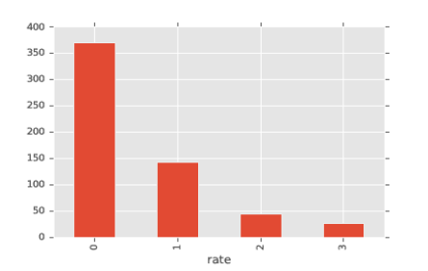
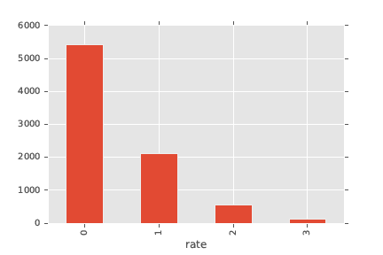
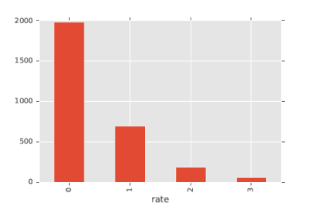
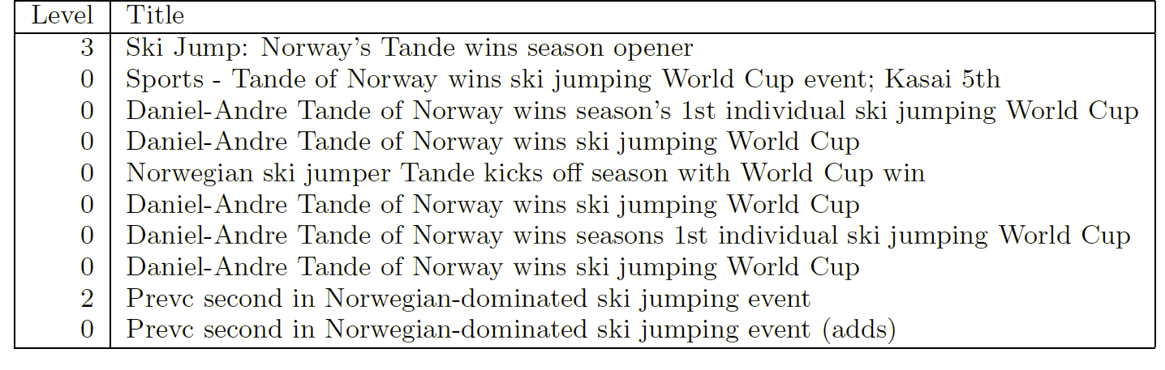
Results 1/2
Good „precision“ (of identified news corresponding to a real-life event)
Relatively more novelty with less news
European Comission (ENG)
Microsoft (ENG)
Borut Pahor (ENG)
Peter Prevc (ENG)
Borut Pahor (SLV)
Peter Prevc (SLV)

Slide 8
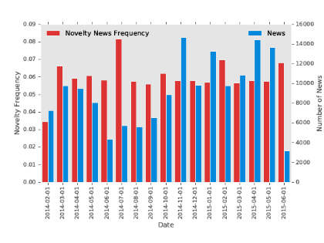
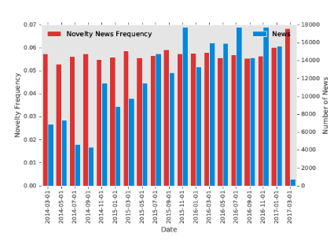
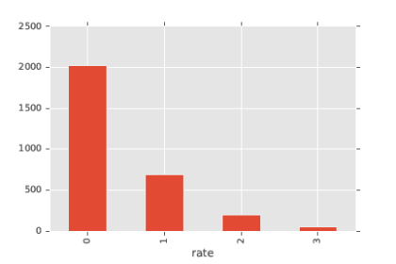
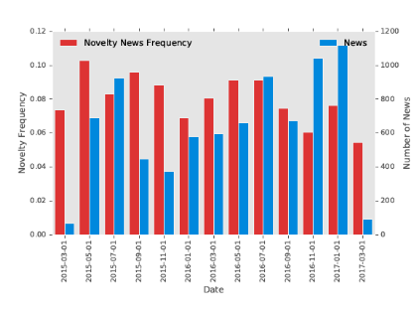
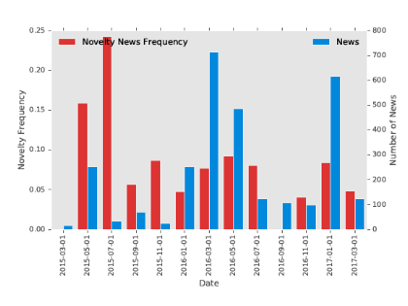
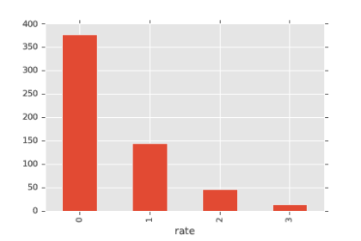
Results 2/2
Novelty through time
More news = more „same old“ news
TFIDF vs TF
TF more strict, results less meaningful by the first glance
Microsoft (ENG)
European Comission (ENG)
Borut Pahor (ENG - TFIDF)
Borut Pahor (ENG – TF)
Borut Pahor (SLV)
Peter Prevc (SLV)
Peter Prevc (ENG – TFIDF)
Peter Prevc (ENG - TF)

Slide 9
Evaluation
No labelled dataset (expensive to create)
Rough evaluation performed post-festum (biased); ~95% accuracy on detecting novelty in a cluster of news for Peter Prevc dataset (N = 103;12 events)
Future work: Could check news sequences against ER events

Slide 10
Conclusion and future work
Labelled dataset needed for proper evaluation (also for feature engineering, parameter tuning)
Some parameters are dataset specific (npr. window for kNN algorithm)
Check methodology with a topic model (like LDA or LSI)
Prototype
Python for reading ER API
NodeJS/Qminer for text processing
Python/Pandas/Numpy for visualization/analysis of results
Runkit
https://runkit.com/klemenkenda/novelty-detection

